Slide 1
TABS (Tragedy assisting band system)

Slide 2

GROUP MEMBERS
SYED MUHAMMAD KHIZER HAIDER (L)
MUHAMMAD ASJAD KASHIF
MUHAMMAD UMAR MALIK
MUHAMMAD SHEES
AIZA TARIQ
MUSKAN KHALIL

Slide 3

TABLE OF CONTENTS
INTRODUCTION
USE CASE
HARDWARE
WORKING & CIRCUIT
CONCLUSION

Slide 4




INTRODUCTION
development OF TABS
Features:
Immediate access to:
Authorities(Police , Fire Brigade etc)
Loved ones(Parents , Siblings , friends etc)
User Interface:
Simple button press for swift assistance
Benefits:
Enhances personal safety and security
Combats harassment effectively

Slide 5
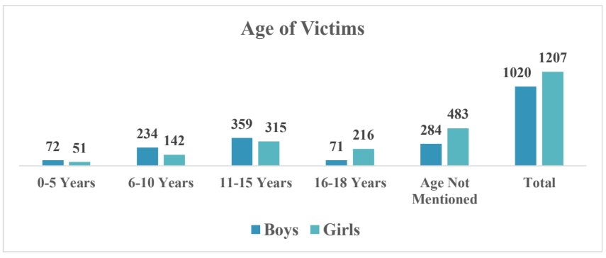

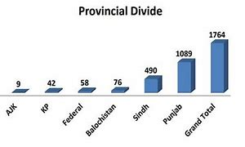

HARRASMENT RATIO IN PAKISTAN
(ANNUALY)
Pakistan has witnessed a surge in reported cases of harassment in recent years.
30/100 are victims of harassment in Pakistan.

Slide 6


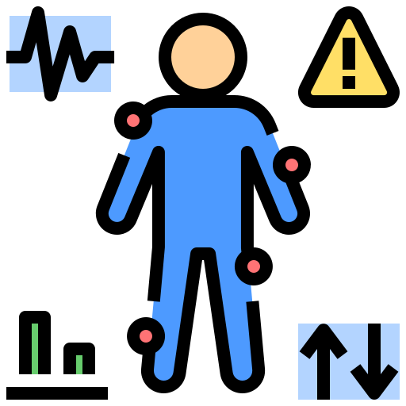

TABS
A compact integrated device that offers
Active tracking
Monitor child activity
Location to authorities in emergency
Urgent assistance to harassed victim

Slide 7


HARDWARE USED
ESP 32(MICRO-CONTROLLER)
SIM 800L(GSM MODULE)
NEO 6M (GPS MODULE)
CHARGING MODULE
5V LIPO BATTERY
PUSH BUTTON

Slide 8
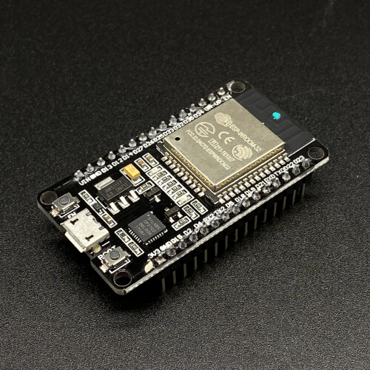
ESP-32
Brain of tabs
Extra CPU cores
240MHZ speed
Bluetooth and WIFI
Notes:
A microcontroller is a small computer on a single integrated circuit (IC) containing a processor core, memory, and programmable input/output peripherals. It is designed to perform specific tasks in embedded systems, which are systems that are part of a larger device or machine. Microcontrollers are commonly used in a wide range of applications, including consumer electronics, automotive systems, industrial automation, medical devices, and more.
The main objective of the ESP32 is to provide a low-cost, low-power system-on-chip microcontroller with integrated Wi-Fi and Bluetooth capabilities for Internet of Things (IoT) applications.
How It Works
Microcontroller Core: Executes programmed instructions to control devices and process data.
Wireless Connectivity: Connects to Wi-Fi networks for internet access and uses Bluetooth for local device communication.
Peripheral Interfaces: Interacts with sensors, actuators, and other hardware through its numerous I/O ports.
Power Management: Offers different power modes to extend battery life in portable applications.
Full form : Espressive system 32 bit

Slide 9
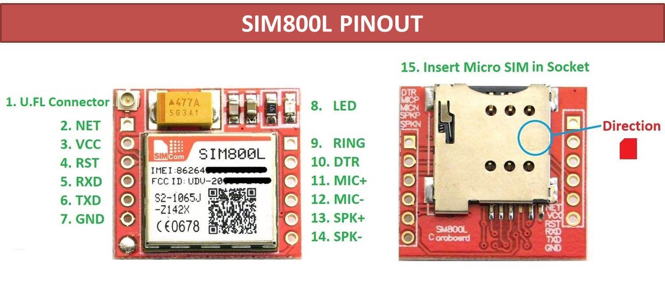
SIM 800L
GSM
Send calls and SMS
Wireless communication with other SIM devices.
Notes:
The SIM8001 is a cellular module developed by SIMCom. It is designed for Internet of Things (IoT) applications, providing GSM/GPRS functionality for communication over cellular networks. Here are the main features of the SIM8001 module:
IoT stands for the Internet of Things. It refers to a network of interconnected devices that can communicate with each other and exchange data over the internet without human intervention. These devices can range from everyday objects, such as household appliances and wearable devices, to industrial machines and sensors embedded in infrastructure.
GSM/GPRS Connectivity: Supports quad-band GSM/GPRS, allowing it to connect to cellular networks globally.
Voice and SMS: Capable of making voice calls and sending/receiving SMS messages.
Data Transmission: Supports GPRS for mobile data communication, suitable for IoT applications that require internet access.
Compact Size: Designed to be small and easy to integrate into various devices.
Low Power Consumption: Optimized for energy efficiency, which is crucial for battery-powered IoT devices.
Interfaces: Provides various interfaces such as UART, SPI, I2C, and GPIO for connecting to other microcontrollers and peripherals.
Additional Features: May include features like TCP/IP stack, FTP/HTTP protocols, and extended AT commands for ease of integration and development.
The SIM8001 is commonly used in applications such as remote monitoring, telematics, smart metering, security systems, and other IoT solutions that require reliable cellular connectivity

Slide 10
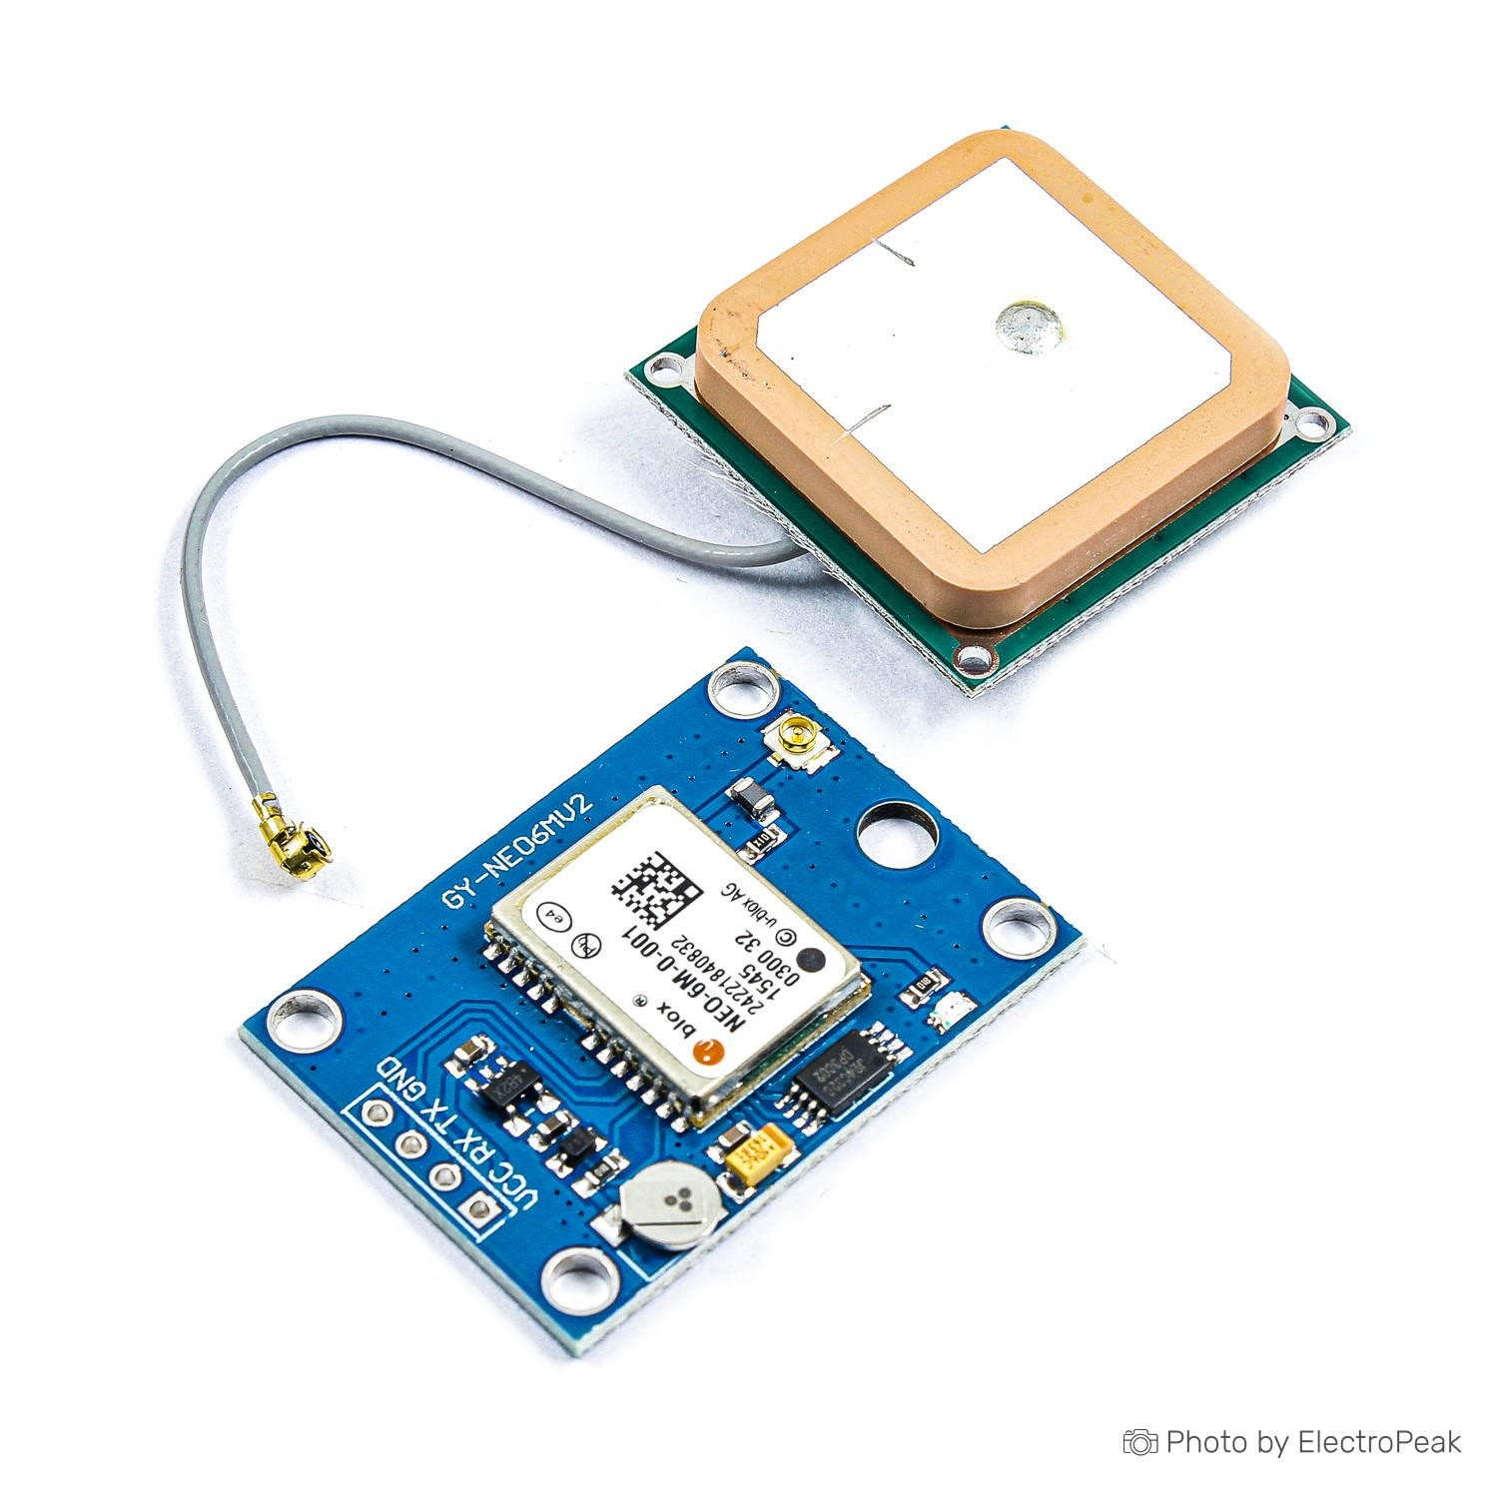
Neo 6m gps module
Provides GPS location
Communicates with satellite
Notes:
Objective
The NEO-6M GPS module provides accurate location data using signals from GPS satellites. It's used in navigation, tracking devices, drones, and robots.
How It Works
Receiving Signals: The module picks up signals from at least four GPS satellites.
Processing Data: It calculates its position (latitude, longitude, altitude), speed, and time by processing these signals.
Outputting Information: The position data is sent out in NMEA format through a serial interface (like UART) to a connected device.
Power Efficiency: The module uses low power, making it suitable for battery-powered devices.
Features
High Sensitivity: Works well even in tough environments.
Quick Startup: Fast to get the first location fix.
Accurate: Position data is usually accurate within 2.5 meters.
Low Power Use: Consumes minimal power.
Easy to Use: Simple to connect and integrate into systems.
Common Uses
Navigation Systems: For cars, boats, and planes.
Tracking Devices: For vehicles, pets, and personal items.
Drones and Robots: For autonomous movement.
Outdoor Activities: For hiking, geocaching, etc.
In short, the NEO-6M GPS module is a reliable, efficient tool for getting precise location data in many different applications.

Slide 11
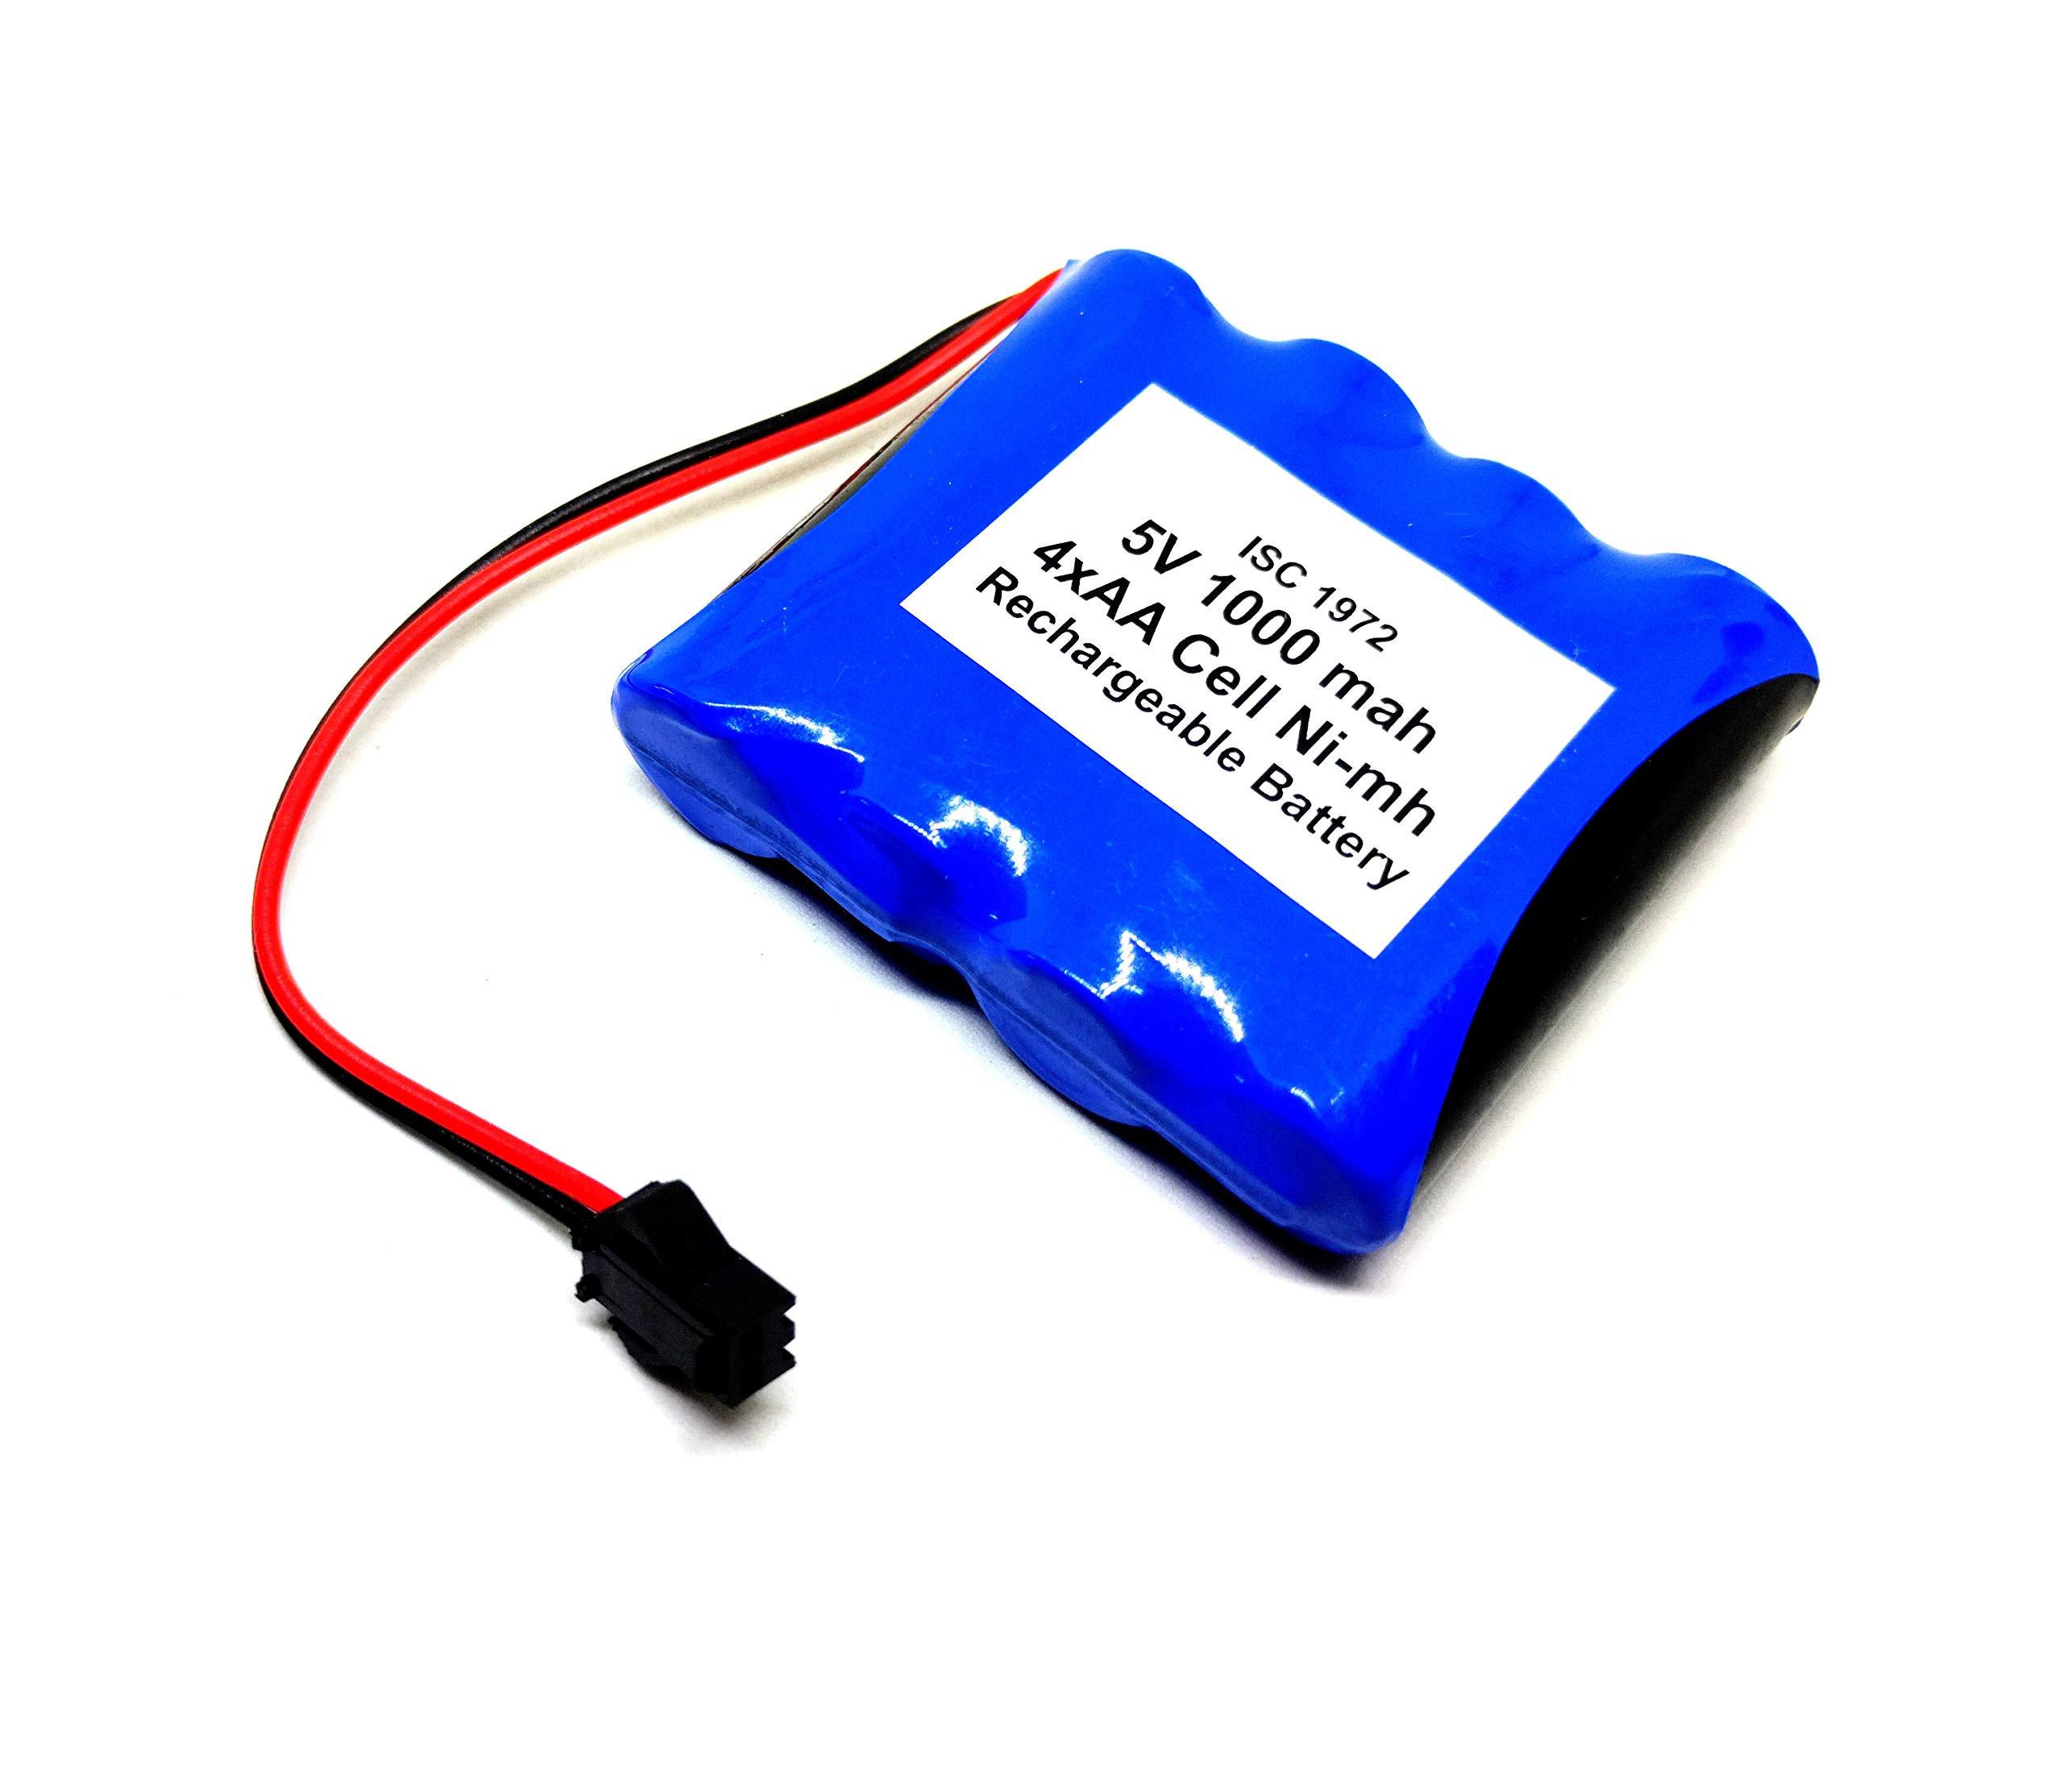
5v battery
A 5V battery for DC power supply.

Slide 12
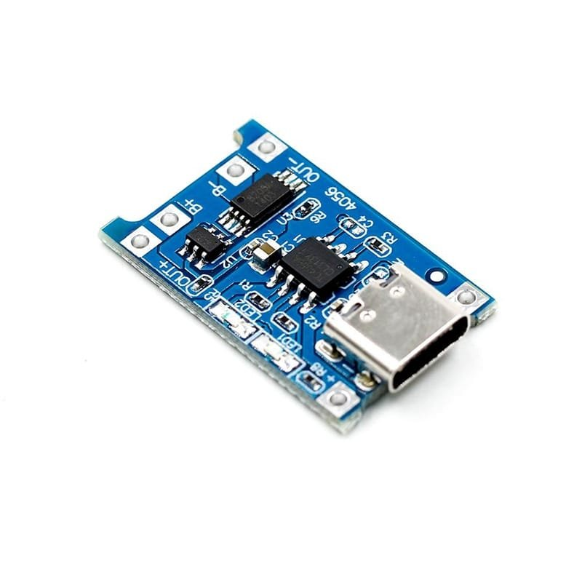
CHARGING MODULE
Charging Lipo battery.
Providing VCC and Gnd from battery to circuit.

Slide 13
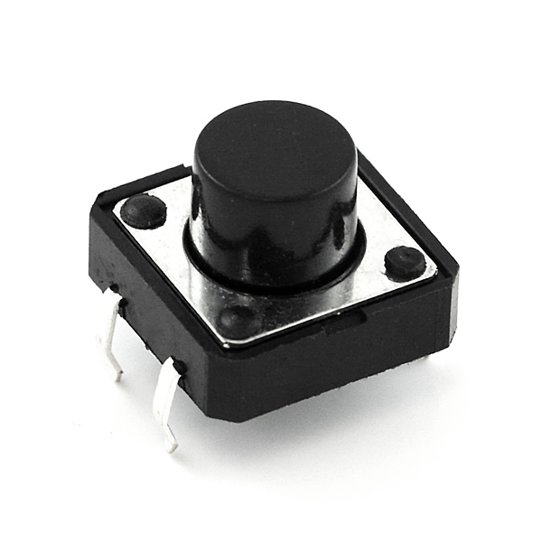
Push button
. Delivering power when needed

Slide 14
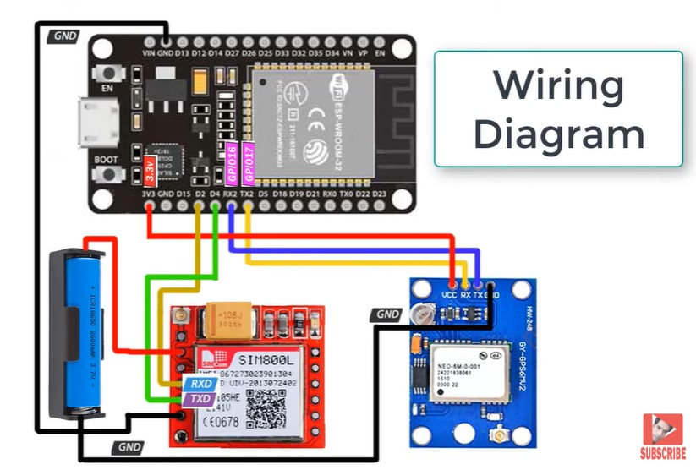
CIRCUIT DIAGRAM
Notes:
Vcc (+ve terminal) and GND (-ve terminal)
Vcc and Gnd are connected from battery to esp 32
SIM Module require 5v current least for power
Esp 32 battery VCC is connected with 5th pin of GSM
Ground is common all the hardware has a single ground.
Esp32 ground is connected with sim8001
D2 of esp is connected with rx of gsm
D4 with tx of gsm
GPS gps require 3.3v least for power therefore esp 32 (3v3 poer is connected with the vcc of gps)
Ground is common connected with battery(with sim8001)
Rx and Tx of GPS
Gps rx is with tx of esp 32
Gps tx is connected with rx of esp 32

Slide 15
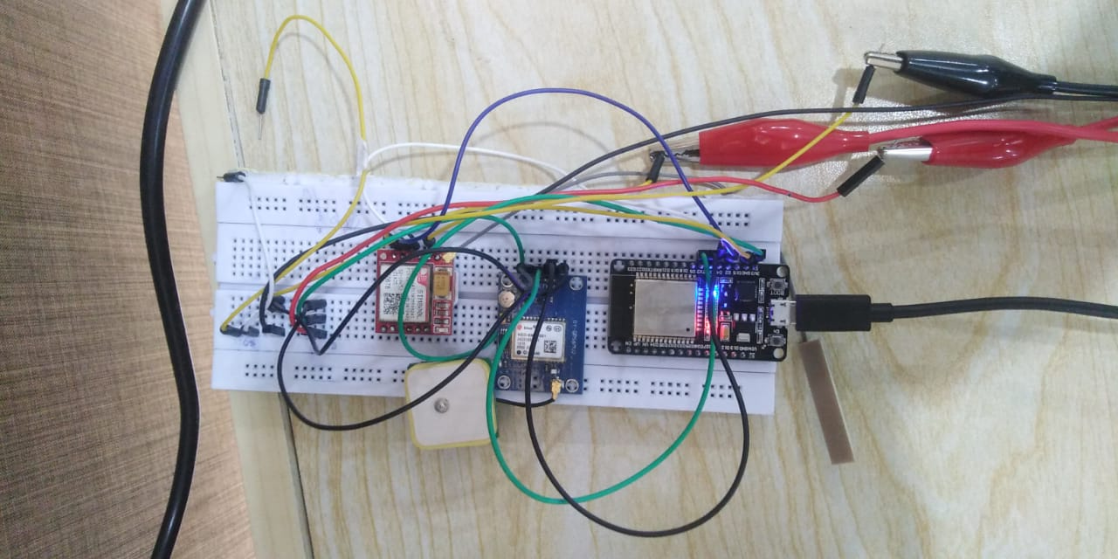
WORKING
When ever a person in a situation needed help. He/she will press the button
The device will immediately, send the location through GSM to the given info/contact no.
After the activation of the device, It will keep sending location after every 5 minutes.
We can also retrieve location, by sending ‘get location’ command to GSM,During the 5 minutes interval.

Slide 16


CONCLUSION
Enhanced Safety: Provides quick location sharing in emergencies, improving response times.
Reliable Communication: Sends SMS alerts with precise location information.
Accurate Tracking: Ensures precise location data for effective assistance.
Portability: Battery-powered for use anywhere.
User-Friendly: Single button press for easy operation.
Practical Application: Ideal for elderly, children, and vulnerable individuals.
Future Potential: Scalable for additional features like fall detection and health monitoring.
Notes:
Enhanced Safety: Our solution facilitates quick location sharing during emergencies, significantly improving response times. Whether it’s a medical crisis or any other urgent situation, our system ensures timely assistance.Reliable Communication: By sending SMS alerts with precise location information, we bridge the communication gap. Emergency responders can act swiftly, knowing exactly where help is needed.Accurate Tracking: Our technology guarantees precise location data. This accuracy is crucial for effective assistance, especially in critical scenarios.Portability: With a battery-powered design, our solution is versatile. It can be used anywhere, making it accessible even in remote areas.User-Friendly Design: A single button press is all it takes to activate our system. This simplicity makes it ideal for everyone, including the elderly, children, and vulnerable individuals.Future Potential: Our system is scalable. Beyond its current features, we envision adding fall detection and health monitoring capabilities.

Slide 17



QUESTIONS AND QUERIES…??

Slide 18
THANK YOU……!!!!!

